Slide 1
Reactive Programming

Slide 2
Content
Collection pipeline
Future
Observer Pattern
Reactive programming
Schedulers

Slide 3
Collection pipeline
source

Slide 4
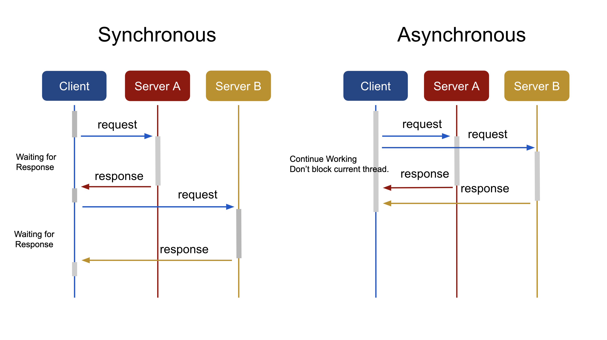
Future
source

Slide 5
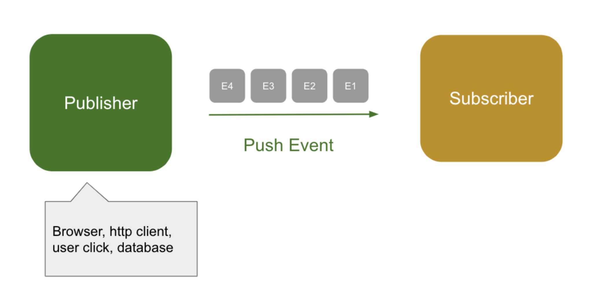
Observer pattern
source

Slide 6
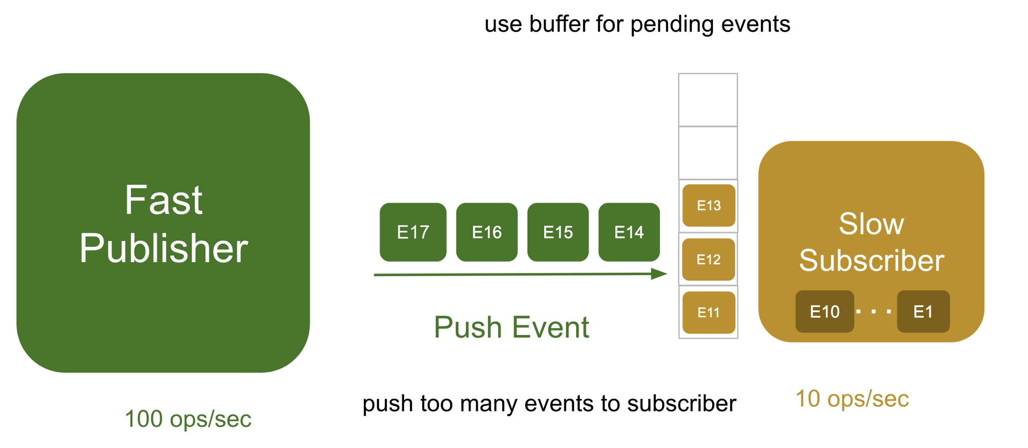
Problem
source

Slide 7
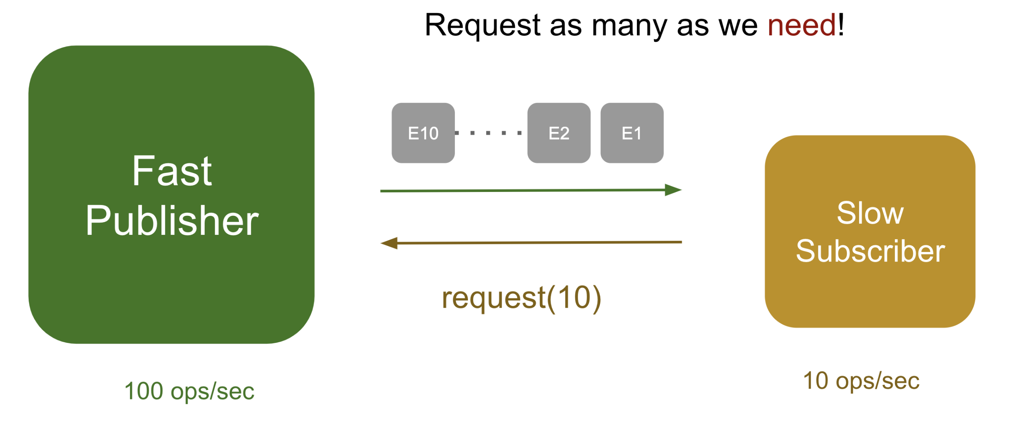
Back pressure
source

Slide 8
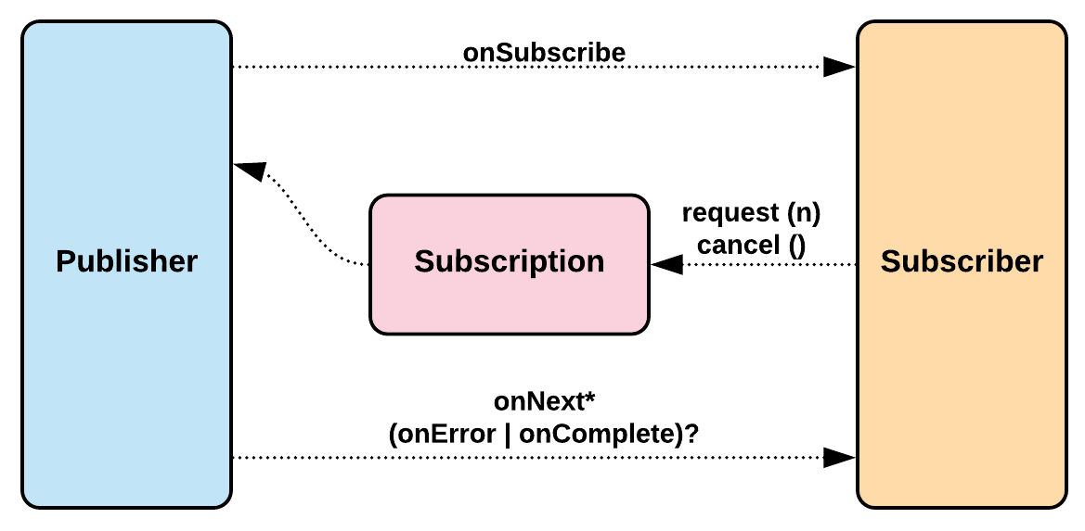
Reactive programming
source

Slide 9
Schedulers
parallel | For CPU intensive tasks (computation)
boundedElastic | For IO intensive tasks (network calls)
immediate | To keep the execution in the current thread
single | A single reusable thread for all the callers
source

Slide 10
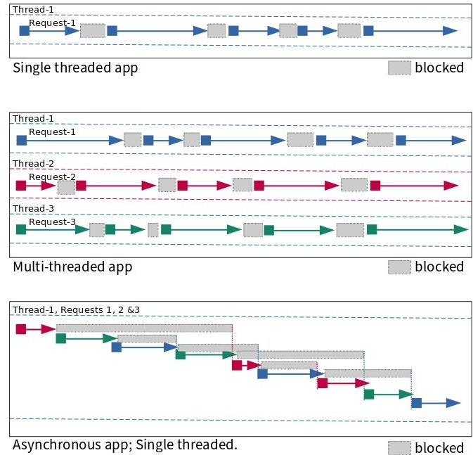
Schedulers
source

Slide 11
Reference
https://www.youtube.com/watch?v=i0lJZeLdAi8&t=3s
https://martinfowler.com/articles/collection-pipeline/
https://engineering.linecorp.com/en/blog/reactive-streams-armeria-1
https://www.vinsguru.com/topics/#webflux
https://callistaenterprise.se/blogg/teknik/2020/05/24/blog-series-reactive-programming/

